Slide 1


Denver Crime Data Analysis
MSDS 692 Practicum I
William Shell
Regis University
wshell@regis.com

Slide 2
Denver Crime Analysis Project Stages
1
Scrub the Data
Model the Data
01
02
03
04
05
Obtain the Data
Explore the Data
Interpret the Data
O
S
E
M
N
Notes:
Acts as both agenda and project overview
Followed typical OSEMN framework

Slide 3
Obtain The Data
2
Incidents
Demographics
Codes
Date Time stamped data of specific incidents
2010 neighborhood statistics of resident demographics and occupancy
Catalog of criminal and non-criminal incident codes
512,946
78
299
Notes:
File sources
City of Denver Open Data Catalog
Downloaded on 09/16/2019
https://www.denvergov.org/opendata/dataset/city-and-county-of-denver-crime
Crime Data
Observation of Incidents by Type, Dates (1st, Last, Report), Locations, Precincts, Crime vs. Traffic and Category
19 attributes w/ 512946 observations
Demographics
2010 Census Data for the City of Denver
Broken out by neighborhood
Include age, ethnicity, occupancy, gender, marital and family composition
127 attributes w/ 78 observations
Crime Codes
Mapping of criminal codes to Offense Type ID (e.g. Theft or Hit and Run) and Offense Category (e.g. larceny or traffic accident)
Criminal versus Traffic classification
8 attributes w/ 299 observations
File Types
*.csv files into a Jupyter Notebook analyzed using Python
Overall Description
As noted above, there are three data sets being used in this analysis the crime data from the City of Denver Open Data Catalog, the City of Denver 2010 Census Data, and the City of Denver Offense Codes.
The Crime Dataset contains 512946 observations of the following 19 attributes:
INCIDENT_ID 512946 non-null float64
OFFENSE_ID 512946 non-null float64
OFFENSE_CODE 512946 non-null int64
OFFENSE_CODE_EXTENSION 512946 non-null int64
OFFENSE_TYPE_ID 512946 non-null object
OFFENSE_CATEGORY_ID 512946 non-null object
FIRST_OCCURRENCE_DATE 512946 non-null object
LAST_OCCURRENCE_DATE 162450 non-null object
REPORTED_DATE 512946 non-null object
INCIDENT_ADDRESS 462825 non-null object
GEO_X 508707 non-null float64
GEO_Y 508707 non-null float64
GEO_LON 508707 non-null float64
GEO_LAT 508707 non-null float64
DISTRICT_ID 512946 non-null int64
PRECINCT_ID 512946 non-null int64
NEIGHBORHOOD_ID 512946 non-null object
IS_CRIME 512946 non-null int64
IS_TRAFFIC 512946 non-null int64
The Census Dataset contains 78 observations of 127 different attributes. For the sake of brevity, the 127 attributes are listed here but generally include information that identifies neighborhoods, resident gender, resident ethnicity, housing, resident age categories, and other demographic data.
The final dataset is the Crime Codes Dataset which contains 299 observations of the following 8 attributes:
OFFENSE_CODE 299 non-null int64
OFFENSE_CODE_EXTENSION 299 non-null int64
OFFENSE_TYPE_ID 299 non-null object
OFFENSE_TYPE_NAME 299 non-null object
OFFENSE_CATEGORY_ID 299 non-null object
OFFENSE_CATEGORY_NAME 299 non-null object
IS_CRIME 299 non-null int64
IS_TRAFFIC 299 non-null int64

Slide 4
Scrub the Data
3
Incidents
Demography
Codes
String to Data Time
Null Values
Left Join
Cleaned and Unified Data Set
Text Clean Up
Primary Key
Convert Text Object to Cat
512,946
Observations
141
Attributes
Notes:
Check for missing values crimeData.isnull().sum() and dropped columns with no value (geo_x, geo_y, last_occurance / report date)
Converted text ed Removed “-” and insert space, made first letter capital on words
Converted primary key NBRHD_ID > NEIGHBORHOOD_ID
Left Join Kept all the incident records and associated them with a census record
CAUTION = summary statistics on census data so be careful in processing
Convert Date Time Date Time was an object converted to a categorical variable and Year, Month, Day, and Hour broken for individual analysis

Slide 5
EDA
4
Time, and Place Incidents
Demographics Associated with Place
Types of Incidents
Notes:
Aggravated Assault
Aggravated Assault 5678
Menacing Felony W Weap 3345
Aggravated Assault Dv 2287
Weapon Fire Into Occ Bldg 682
Weapon Fire Into Occ Veh 176
All Other Crimes
Agg Aslt Police Weapon 317
Accessory Conspiracy To Crime 147
Animal Cruelty To 147
Animal Poss Of Dangerous 15
Aslt Agg Police Gun 10
Arson
Arson Other 196
Arson Vehicle 194
Arson Residence 164
Arson Business 73
Arson Public Building 18
Auto Theft
Theft Of Motor Vehicle 26728
Theft Stln Vehicle Trailer 534
Theft Stln Veh Const Eqpt 47
Burglary
Burglary Business By Force 5128
Burg Auto Theft Resd No Force 440
Burg Auto Theft Resd W Force 174
Burg Auto Theft Busn W Force 146
Burg Auto Theft Busn No Force 47
Drug Alcohol
Drug Cocaine Possess 3131
Drug Cocaine Sell 1505
Drug Barbiturate Possess 38
Drug Barbiturate Sell 14
Drug Barbiturate Mfr 2
Larceny Theft Bicycle 8581
Theft From Bldg 5629
Theft From Mails 478
Burglary Vending Machine 235
Theft From Yards 1
Murder
Homicide Other 251
Homicide Family 27
Traf Vehicular Homicide 25
Homicide Negligent 2
Homicide Police By Gun 2
Other Crimes Against Persons
Assault Simple 14136
Assault Dv 9358
Indecent Exposure 846
Assault Police Simple 760
Obscene Material Mfr 6
Public Disorder
Criminal Mischief Mtr Veh 15531
Criminal Mischief Other 13782
Disturbing The Peace 8796
Criminal Mischief Graffiti 3158
Curfew 1562
Robbery
Robbery Business 1572
Robbery Car Jacking 649
Robbery Residence 419
Robbery Purse Snatch W Force 352
Robbery Bank 161
Sexual Assault
Sex Aslt Rape 2407
Sex Aslt Fondle Adult Victim 896
Sex Aslt Non Rape 593
Sex Aslt Rape Pot 163
Sex Aslt Non Rape Pot 138
Theft From Motor Vehicle
Theft Items From Vehicle 27713
Theft Parts From Vehicle 11154
Traffic Accident
Traffic Accident 93037
Traffic Accident Hit And Run 36244
Traffic Accident Dui Duid 3992
White Collar Crime
Forgery Checks 950
Forgery Other 346
Forgery Counterfeit Of Obj 113
Drug Forgery To Obtain 98
Altering Vin Number 1

Slide 6
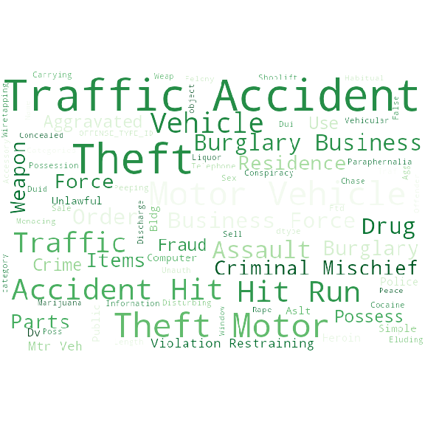
EDA Types of Incidents
4
72%
Top 5 Incidents
Traffic Accident | 133273 | 26%
All Other Crimes | 92841 | 18%
Public Disorder | 53389 | 10%
Larceny | 52027 | 10%
Theft From Motor Vehicle | 38867 | 8%
Notes:
Aggravated Assault
Aggravated Assault 5678
Menacing Felony W Weap 3345
Aggravated Assault Dv 2287
Weapon Fire Into Occ Bldg 682
Weapon Fire Into Occ Veh 176
All Other Crimes
Agg Aslt Police Weapon 317
Accessory Conspiracy To Crime 147
Animal Cruelty To 147
Animal Poss Of Dangerous 15
Aslt Agg Police Gun 10
Arson
Arson Other 196
Arson Vehicle 194
Arson Residence 164
Arson Business 73
Arson Public Building 18
Auto Theft
Theft Of Motor Vehicle 26728
Theft Stln Vehicle Trailer 534
Theft Stln Veh Const Eqpt 47
Burglary
Burglary Business By Force 5128
Burg Auto Theft Resd No Force 440
Burg Auto Theft Resd W Force 174
Burg Auto Theft Busn W Force 146
Burg Auto Theft Busn No Force 47
Drug Alcohol
Drug Cocaine Possess 3131
Drug Cocaine Sell 1505
Drug Barbiturate Possess 38
Drug Barbiturate Sell 14
Drug Barbiturate Mfr 2
Larceny Theft Bicycle 8581
Theft From Bldg 5629
Theft From Mails 478
Burglary Vending Machine 235
Theft From Yards 1
Murder
Homicide Other 251
Homicide Family 27
Traf Vehicular Homicide 25
Homicide Negligent 2
Homicide Police By Gun 2
Other Crimes Against Persons
Assault Simple 14136
Assault Dv 9358
Indecent Exposure 846
Assault Police Simple 760
Obscene Material Mfr 6
Public Disorder
Criminal Mischief Mtr Veh 15531
Criminal Mischief Other 13782
Disturbing The Peace 8796
Criminal Mischief Graffiti 3158
Curfew 1562
Robbery
Robbery Business 1572
Robbery Car Jacking 649
Robbery Residence 419
Robbery Purse Snatch W Force 352
Robbery Bank 161
Sexual Assault
Sex Aslt Rape 2407
Sex Aslt Fondle Adult Victim 896
Sex Aslt Non Rape 593
Sex Aslt Rape Pot 163
Sex Aslt Non Rape Pot 138
Theft From Motor Vehicle
Theft Items From Vehicle 27713
Theft Parts From Vehicle 11154
Traffic Accident
Traffic Accident 93037
Traffic Accident Hit And Run 36244
Traffic Accident Dui Duid 3992
White Collar Crime
Forgery Checks 950
Forgery Other 346
Forgery Counterfeit Of Obj 113
Drug Forgery To Obtain 98
Altering Vin Number 1

Slide 7
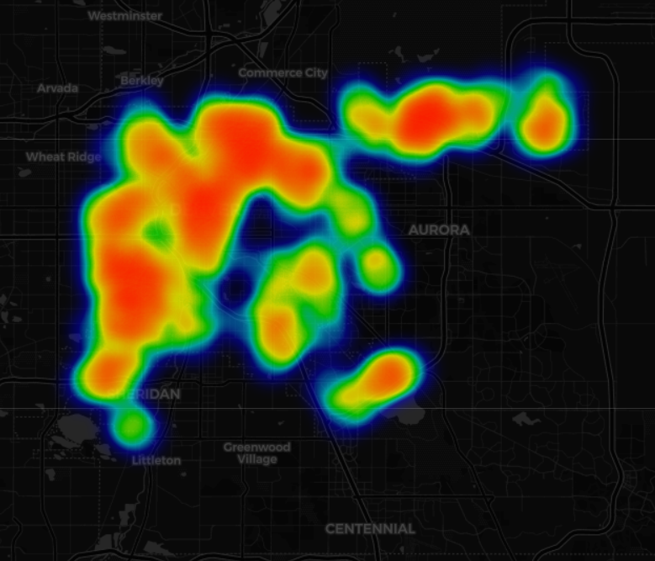
EDA Location of Incidents
5
32%
of Incidents Concentrated in 13% of Neighbourhoods
Five Points | 26947 | 5%
Stapleton | 22091 | 4%
Cbd | 19034 | 4%
Capitol Hill | 17707 | 3%
Montbello | 17446 | 3%
Baker | 14050 | 3%
Lincoln Park | 13760 | 3%
East Colfax | 13383 | 3%
Westwood | 12607 | 2%
Civic Center | 12332 | 2%
Notes:
The top neighborhoods with the most criminal offenses recorded were Five-Points, Stapleton, Cbd, Capital Hill, etc. to East/West Colfax. The least criminally active areas around Denver were Indian-Creek with only 502 reports, compared to Five-Point’s 26947 accounts.

Slide 8
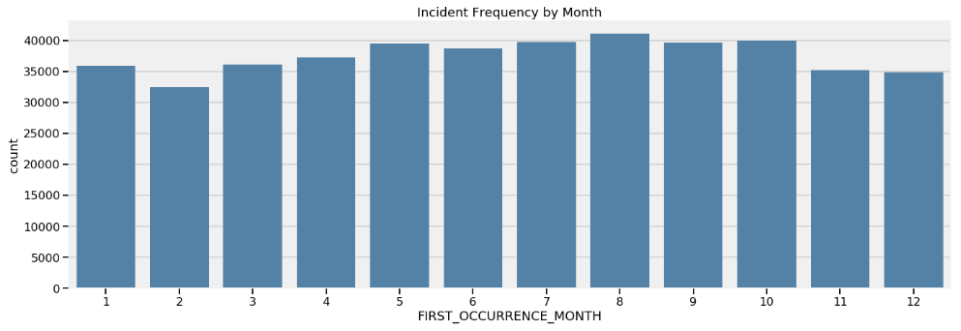
EDA Time of Incidents
6
12%
Incident Increase from 2014 – 2019
83K to 93K per year
38%
Incident that Occur between May and August
Midnight to 4 AM | 16%
4 AM to 8 AM | 8%
8 AM to 12 PM | 18%
12 PM to 4 PM | 20%
4 PM to 8 PM | 22%
8 PM to Midnight | 16%
Notes:
The Percent Increase from 2014 to 2019 is : 12.48 %
In 2014, there were 83,059 incidents increasing to 93,427 in 2018. This is an increase of 12.4% over that 5 year span.
FIRST_OCCURRENCE_MONTH INCIDENT_ID
0 1 35933
1 2 32430
2 3 36119
3 4 37192
4 5 39455
5 6 38732
6 7 39752
7 8 41109
8 9 39664
9 10 39958
10 11 35157
11 12 34911
Liquor possession ranked highest in the drug-alcohol violations
Possession of drug paraphernalia ranked second, followed by possession of marijuana
Methamphetamine possession breaks the pattern of annual declines in incidents – it actually grew from 2014-2016
Cocaine and heroin possession also grew, but at a much smaller volume than methamphetamine

Slide 9
EDA Demographics
7
600K
Residents
Neighborhood | Population | % of Total
Montebello | 30348 | 5%
Gateway Green Valley | 22091 | 4%
Hampden | 17547 | 3%
Westwood | 14708 | 2%
Capitol Hill | 14370 | 2%
Stapleton | 13948 | 2%
Washington Virginia Vale | 13030 | 2%
Virginia Village | 12844 | 2%
Five Points | 12712 | 2%
$62K
Annual Median Income
286K
Households
Notes:
City and County of Denver contained 600,158 people and 285,797 households.
NEIGHBORHOOD_ID MALE FEMALE
0 Athmar Park 4597 4301
1 Auraria 352 353
2 Baker 2565 2314
3 Barnum 3144 2967
4 Barnum West 2754 2622
5 Bear Valley 4396 4493
6 Belcaro 2009 2163
7 Berkeley 3884 4228
8 Capitol Hill 8331 6377
9 CBD 2016 1632
10 Chaffee Park 1932 1942
11 Cheesman Park 4116 3855
12 Cherry Creek 2488 3101
13 City Park 1410 1497
14 City Park West 2388 2456
15 Civic Center 886 691
16 Clayton 2173 2163
17 Cole 2382 2269
18 College View / South Platte 3459 3039
19 Congress Park 5110 5125
20 Cory - Merrill 1927 1965
21 Country Club 1443 1558
22 DIA 520 645
23 East Colfax 5147 5044
24 Elyria Swansea 3280 3121
25 Five Points 7440 5272
26 Fort Logan 4189 4343
27 Gateway / Green Valley Ranch 14160 15041
28 Globeville 2027 1660
29 Goldsmith 2956 2852
30 Hale 3521 3415
31 Hampden 8438 9109
32 Hampden South 6974 7396
33 Harvey Park 5738 5787
34 Harvey Park South 4090 4303
35 Highland 4309 4120
36 Hilltop 3863 4327
37 Indian Creek 1314 1782
38 Jefferson Park 1419 1133
39 Kennedy 2469 1995
40 Lincoln Park 3126 2993
41 Lowry Field 3678 4389
42 Mar Lee 6291 6161
43 Marston 5289 5843
44 Montbello 15111 15237
45 Montclair 2626 2830
46 North Capitol Hill 3415 2408
47 North Park Hill 4421 4961
48 Northeast Park Hill 3736 4086
49 Overland 1195 1023
50 Platt Park 2603 2790
51 Regis 1884 2050
52 Rosedale 1243 1310
53 Ruby Hill 4915 4905
54 Skyland 1496 1610
55 Sloan Lake 3452 3786
56 South Park Hill 4105 4485
57 Southmoor Park 1885 1941
58 Speer 5607 5347
59 Stapleton 7308 6640
60 Sun Valley 580 868
61 Sunnyside 4862 4864
62 Union Station 2351 1997
63 University 4755 4620
64 University Hills 2605 2722
65 University Park 3708 3783
66 Valverde 1925 2016
67 Villa Park 4528 4230
68 Virginia Village 6487 6357
69 Washington Park 3378 3527
70 Washington Park West 3258 3135
71 Washington Virginia Vale 6273 6757
72 Wellshire 1465 1668
73 West Colfax 4839 4901
74 West Highland 4144 4396
75 Westwood 7928 7558
76 Whittier 2380 2451
77 Windsor 5621 6968

Slide 10
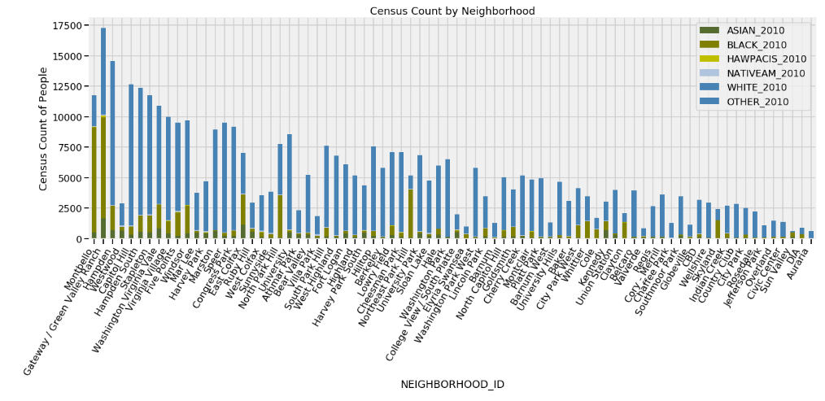
EDA Demographics
8
Notes:
City and County of Denver contained 600,158 people and 285,797 households.
NEIGHBORHOOD_ID MALE FEMALE
0 Athmar Park 4597 4301
1 Auraria 352 353
2 Baker 2565 2314
3 Barnum 3144 2967
4 Barnum West 2754 2622
5 Bear Valley 4396 4493
6 Belcaro 2009 2163
7 Berkeley 3884 4228
8 Capitol Hill 8331 6377
9 CBD 2016 1632
10 Chaffee Park 1932 1942
11 Cheesman Park 4116 3855
12 Cherry Creek 2488 3101
13 City Park 1410 1497
14 City Park West 2388 2456
15 Civic Center 886 691
16 Clayton 2173 2163
17 Cole 2382 2269
18 College View / South Platte 3459 3039
19 Congress Park 5110 5125
20 Cory - Merrill 1927 1965
21 Country Club 1443 1558
22 DIA 520 645
23 East Colfax 5147 5044
24 Elyria Swansea 3280 3121
25 Five Points 7440 5272
26 Fort Logan 4189 4343
27 Gateway / Green Valley Ranch 14160 15041
28 Globeville 2027 1660
29 Goldsmith 2956 2852
30 Hale 3521 3415
31 Hampden 8438 9109
32 Hampden South 6974 7396
33 Harvey Park 5738 5787
34 Harvey Park South 4090 4303
35 Highland 4309 4120
36 Hilltop 3863 4327
37 Indian Creek 1314 1782
38 Jefferson Park 1419 1133
39 Kennedy 2469 1995
40 Lincoln Park 3126 2993
41 Lowry Field 3678 4389
42 Mar Lee 6291 6161
43 Marston 5289 5843
44 Montbello 15111 15237
45 Montclair 2626 2830
46 North Capitol Hill 3415 2408
47 North Park Hill 4421 4961
48 Northeast Park Hill 3736 4086
49 Overland 1195 1023
50 Platt Park 2603 2790
51 Regis 1884 2050
52 Rosedale 1243 1310
53 Ruby Hill 4915 4905
54 Skyland 1496 1610
55 Sloan Lake 3452 3786
56 South Park Hill 4105 4485
57 Southmoor Park 1885 1941
58 Speer 5607 5347
59 Stapleton 7308 6640
60 Sun Valley 580 868
61 Sunnyside 4862 4864
62 Union Station 2351 1997
63 University 4755 4620
64 University Hills 2605 2722
65 University Park 3708 3783
66 Valverde 1925 2016
67 Villa Park 4528 4230
68 Virginia Village 6487 6357
69 Washington Park 3378 3527
70 Washington Park West 3258 3135
71 Washington Virginia Vale 6273 6757
72 Wellshire 1465 1668
73 West Colfax 4839 4901
74 West Highland 4144 4396
75 Westwood 7928 7558
76 Whittier 2380 2451
77 Windsor 5621 6968

Slide 11
Modelling
9
1
KNN on IS_CRIME is a simple 0 or 1 classification
2
KNN on INCIDENT_CATEGORY_ID has up to 15 potential classifications
3
Cross Fold validation for best value of K
4
Removed features redundant with crime classifications above (e.g. offense codes etc.

Slide 12
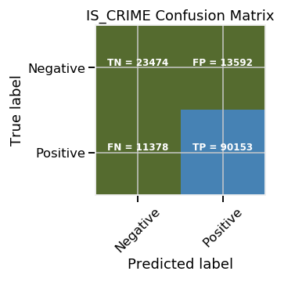
Performance
10
82%
Model 1 – IS_CRIME
39%
Model 2 – INCIDENT_CATEGORY_ID
Notes:
Precision and recall are two extremely important model evaluation metrics. While precision refers to the percentage of your results which are relevant, recall refers to the percentage of total relevant results correctly classified by your algorithm
Model 1
0.7179376176973528
[[10410 26786]
[12307 89094]]
precision recall f1-score support
0 0.46 0.28 0.35 37196
1 0.77 0.88 0.82 101401
accuracy 0.72 138597
macro avg 0.61 0.58 0.58 138597
weighted avg 0.69 0.72 0.69 138597
Model 2
precision recall f1-score support
Aggravated Assault 0.06 0.03 0.04 3278
All Other Crimes 0.28 0.48 0.35 25231
Arson 0.00 0.00 0.00 172
Auto Theft 0.11 0.07 0.09 7401
Burglary 0.10 0.06 0.07 7188
Drug Alcohol 0.24 0.21 0.22 9227
Larceny 0.20 0.16 0.18 13271
Murder 0.00 0.00 0.00 96
Other Crimes Against Persons 0.08 0.03 0.04 6835
Public Disorder 0.17 0.12 0.14 14509
Robbery 0.03 0.00 0.00 1707
Sexual Assault 0.00 0.00 0.00 2
Theft From Motor Vehicle 0.16 0.08 0.11 10585
Traffic Accident 0.40 0.51 0.45 37301
White Collar Crime 0.04 0.00 0.00 1794
accuracy 0.28 138597
macro avg 0.12 0.12 0.11 138597
weighted avg 0.24 0.28 0.25 138597

Slide 13
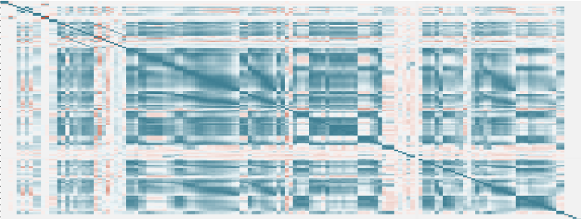
Follow On Work
11
Explore Alternate Classification Models
N E X T
Deep Dive Correlations
Deeper Ethnicity and Crime Analysis
Explore
Income and Crime Impacts
S T E P S
Notes:
Logistic Regression. Definition: Logistic regression is a machine learning algorithm for classification. ...
Naïve Bayes. ...
Stochastic Gradient Descent. ...
Decision Tree. ...
Random Forest. ...
Support Vector Machine.

Slide 14
References
12
Denver Open Data Catalog: Crime. (n.d.). Retrieved from https://www.denvergov.org/opendata/dataset/city-and-county-of-denver-crime
Dr. Cher Han Lau. (2019, January 10). 5 Steps of a Data Science Project Lifecycle. Retrieved from https://towardsdatascience.com/5-steps-of-a-data-science-project-lifecycle-26c50372b492
Generating WordClouds in Python. (n.d.). Retrieved from https://www.datacamp.com/community/tutorials/wordcloud-python
Petrou, T. (2019, October 1). Selecting Subsets of Data in Pandas: Part 1. Retrieved from https://medium.com/dunder-data/selecting-subsets-of-data-in-pandas-6fcd0170be9c
Python | Pandas DataFrame. (n.d.). Retrieved from https://www.geeksforgeeks.org/python-pandas-dataframe/
Sharma, M. (2018, November 3). Data Visualization using Seaborn. Retrieved from https://towardsdatascience.com/data-visualization-using-seaborn-fc24db95a850
Style sheets reference — Matplotlib 3.1.1 documentation. (n.d.). Retrieved from https://matplotlib.org/3.1.1/gallery/style_sheets/style_sheets_reference.html
Summarising, Aggregating, and Grouping data in Python Pandas. (2019, October 6). Retrieved from https://www.shanelynn.ie/summarising-aggregation-and-grouping-data-in-python-pandas/

